Slide 1
Shortest Common Superstring
Utku Gökberk Şen Ata Sarp Mildan Furkan Eken Faik Şahin Alp Dinçer

Slide 2
OUTLINE
Problem Description
Algorithm Description
Algorithm Analysis
Experimental Analysis
Testing
Conclusion

Slide 3
Problem Description
The Shortest Common Superstring (SCS)
It is a problem for optimization on sequences. These sequence vary into areas such as;
DNA genome projects.
DNA sequence assembly in Computational Biology.
Computer Science and Engineering problems scheduling.
Query optimization.
Data compression and text-editing.

Slide 4
Problem Description
The Shortest Common Superstring (SCS)
Problem: Is there a binary string w of length at most k such that every string in R is a substring of w, i.e. for each r in R, w can be decomposed as w = w₀rw₁ where w₀, w₁ are (possibly empty) binary strings?
Suppose we are given the following input S (binary string):
000 001 010 011 100 101 110 111

Slide 5
Problem Description
The Shortest Common Superstring (SCS)
Solution: Try orders for input S and construct the Superstring.
Order 1: 000 001 010 011 100 101 110 111

Slide 6
Problem Description
The Shortest Common Superstring (SCS)
Solution: Try orders for input S and construct the Superstring.
Order 1: 000 001 010 011 100 101 110 111
0001

Slide 7
Problem Description
The Shortest Common Superstring (SCS)
Solution: Try orders for input S and construct the Superstring.
Order 1: 000 001 010 011 100 101 110 111
00010

Slide 8
Problem Description
The Shortest Common Superstring (SCS)
Solution: Try orders for input S and construct the Superstring.
Order 1: 000 001 010 011 100 101 110 111
0001011

Slide 9
Problem Description
The Shortest Common Superstring (SCS)
Solution: Try orders for input S and construct the Superstring.
Order 1: 000 001 010 011 100 101 110 111
000101100

Slide 10
Problem Description
The Shortest Common Superstring (SCS)
Solution: Try orders for input S and construct the Superstring.
Order 1: 000 001 010 011 100 101 110 111
000101100101

Slide 11
Problem Description
The Shortest Common Superstring (SCS)
Solution: Try orders for input S and construct the Superstring.
Order 1: 000 001 010 011 100 101 110 111
00010110010110

Slide 12
Problem Description
The Shortest Common Superstring (SCS)
Solution: Try orders for input S and construct the Superstring.
Order 1: 000 001 010 011 100 101 110 111
00010110010110111
Superstring 1

Slide 13
Problem Description
The Shortest Common Superstring (SCS)
Solution: Try orders for input S and construct the Superstring.
Order 1: 000 001 010 011 100 101 110 111
00010110010110111
Order 2: 000 001 010 101 011 111 100 110
0001011100110
Superstring 1
Superstring 2

Slide 14
Problem Description
The Shortest Common Superstring (SCS)
Solution: Try orders for input S and construct the Superstring.
How many orders are there?
If our input has n strings, we have n! possible orderings.
BUT! This is not a feasible solution with high volume input sets.
What if we have a MILLION strings? We can’t try all orders.

Slide 15
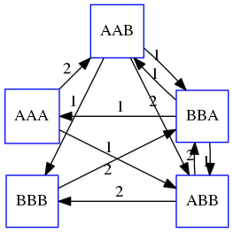
Problem Description
The Shortest Common Superstring (SCS)
Therefore we require an approximate algorithm to compute this in polynomial time.
First, we will prove this problem is a NP-Complete problem.
It is a reduction from Hamiltonian Path.

Slide 16
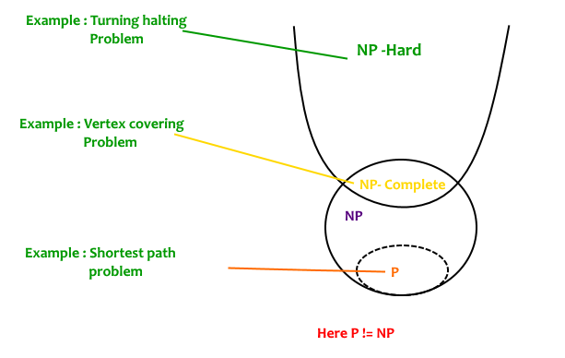
Problem Description
According to [Nikola Kapamadzin,2015] “NP Completeness of Hamiltonian Circuits and Paths” Hamiltonian circuits can be reduced to the vertex cover problem, and then that Hamiltonian Paths can be reduced to Hamiltonian Circuits.
This will complete our logic bringing us to the conclusion that Shortest Common Superstring is NP Complete because we will use Hamiltonian Circuits to solve our problem.

Slide 17
Problem Description
Proof
First we reduce the Vertex Cover problem to the Hamiltonian Path problem.
By using Hamiltonian Path and a greedy algorithm we can show that Shortest Common Substring problem can be solved in polynomial time.
1) First we need to show that Hamiltonian Paths in NP.
2) Show Hamiltonian Circuits NP-Hard.

Slide 18
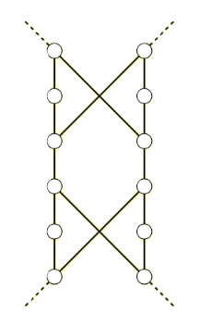
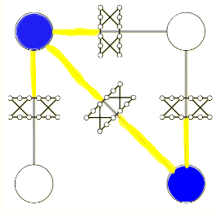
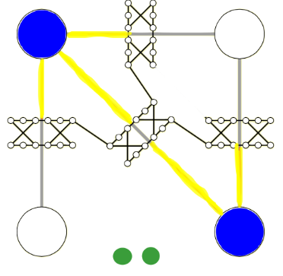
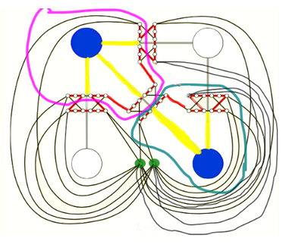
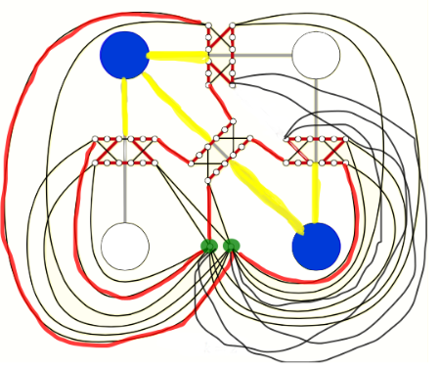
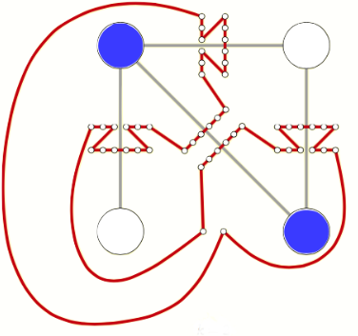
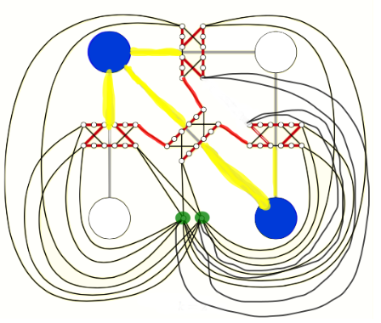
NOTE: SCS is a NP-Complete problem. The figures on the left shows the reduction to Hamiltonian Paths from Vertex to Cover.
We explained in more detail in our report

Slide 19
Algorithm Description
Although there is no optimal way to solve the SCS problem in polynomial time, there are some solutions with an error margin.
Greedy SCS algorithm and Reduce-Expand algorithm (which is more efficient) with a time and space O(n² + nk) are two such ways to solve SCS to an extend.
Our aim is to get a closer look at how greedy algorithm handles this problem and analyze its performance.
In practice this algorithm is very similar to Hamiltonian Path.

Slide 20
Algorithm Description
What is different from Hamiltonian?
We take the highest weighted edges in our graph, instead of taking the lowest ones.
The weights are calculated according to the lengths of the maximum overlaps between strings.
Instead of deriving a path instantly, we choose the highest valued edges at once and merge the two nodes corresponding to that edge.
This method ensures that we only traverse every node once and do not get in a loop.

Slide 21
Algorithm Description
Steps of The Algorithm
At the beginning, it finds the most overlapping string pair of two.
Then it combines these two strings by their overlapping parts.
Removes the used strings and replaces them with the new combined string.
Repeats these steps above if there are multiple strings left.
If there is only one string left, it is our SCS.

Slide 22
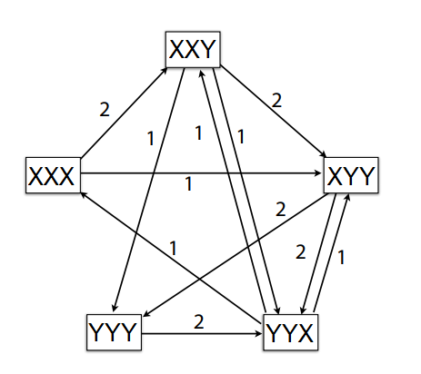
Algorithm Example Case

Slide 23
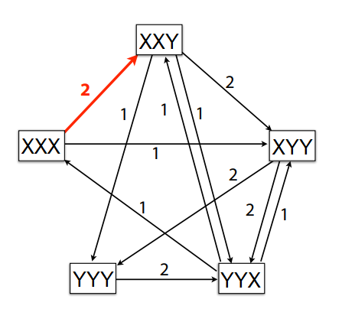
Algorithm Example Case

Slide 24
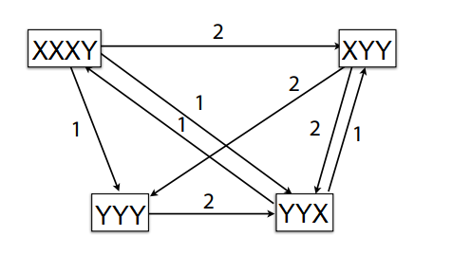
Algorithm Example Case

Slide 25
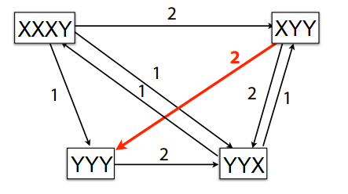
Algorithm Example Case

Slide 26
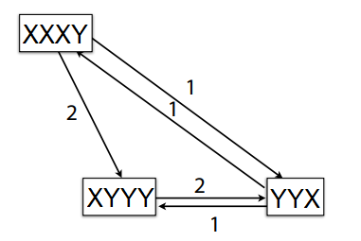
Algorithm Example Case

Slide 27
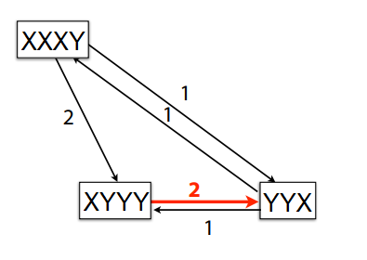
Algorithm Example Case

Slide 28
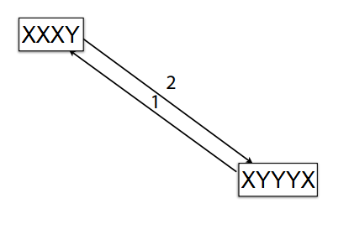
Algorithm Example Case

Slide 29
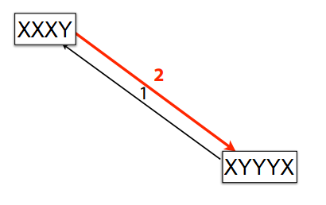
Algorithm Example Case

Slide 30
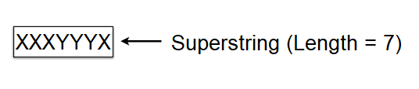
Algorithm Example Case

Slide 31
Algorithm Analysis
This algorithm we are proposing does not guarantee that it will find the SCS.
It is an approximate greedy algorithm.
We always choose the maximum overlap available at that particular moment without foreseeing optimal case.
But it is guaranteed that it will generate a Superstring whether it is the shortest one or not.
That is because we are using an approach similar to the Hamiltonian Path algorithm.
We use every string and only once.

Slide 32
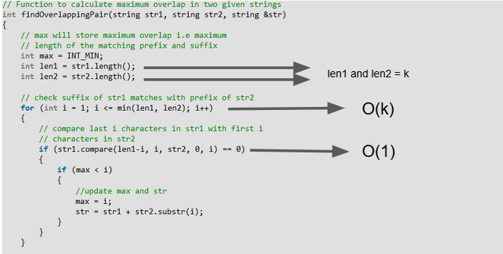
Algorithm Analysis

Slide 33
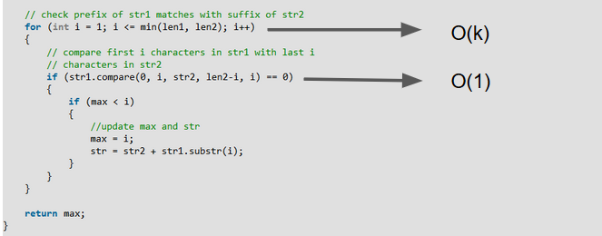
Algorithm Analysis

Slide 34
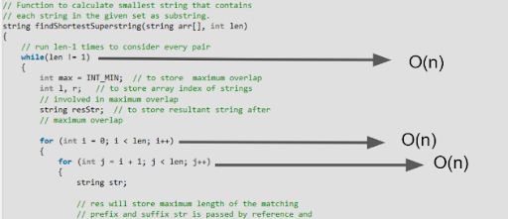
Algorithm Analysis

Slide 35
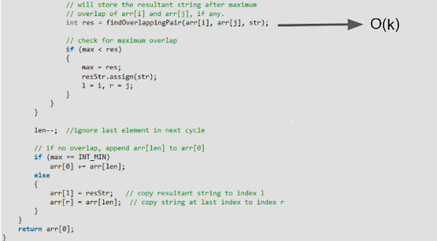
Algorithm Analysis
Running Time: O(k)* O(n*n *n) = O(k*n³)

Slide 36
Experimental Analysis
Success Rate (How to Calculate?)
We create a function to do below steps for calculate success rate:
1) Randomly select random 3 character from char array which is our alphabet. Append them a empty string variable.
2) Append the string variable to string list.
3) Until reach the desired string list length repeat step 1 and step 2.
4) Use string list as input on Greedy Algorithm of SCS and Dynamic Programming Algorithm of SCS (Brute Force) and compare output.

Slide 37
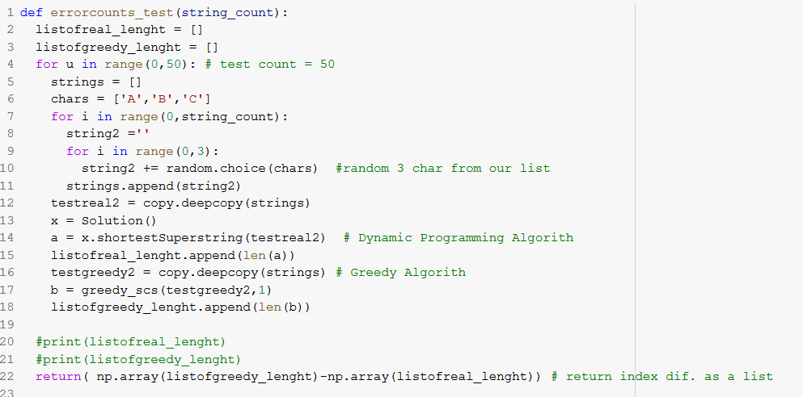
errorcounts_test(string_count)

Slide 38
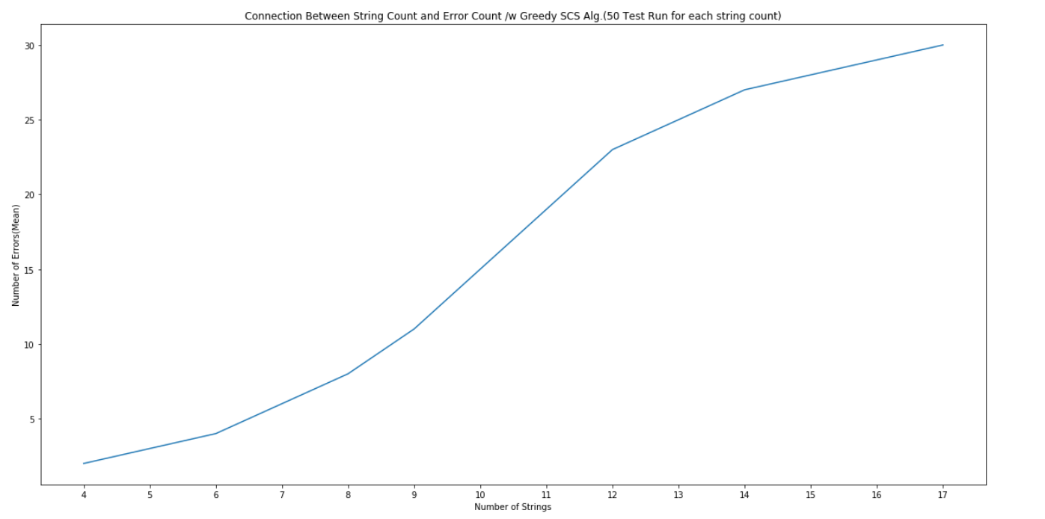

Slide 39
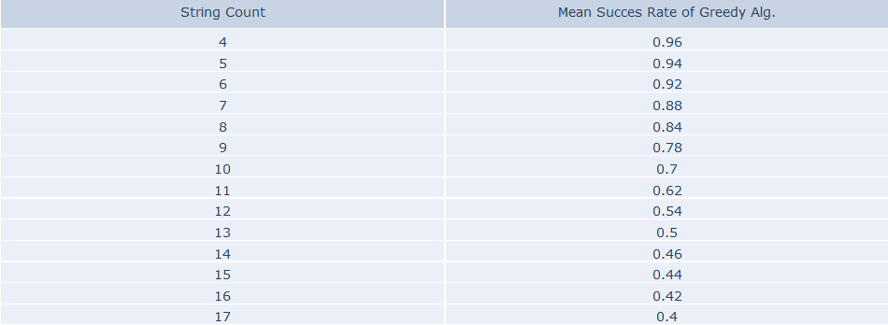
Success Rate (At The String Count) = (Total Test Count - Mean of Error Count) / Total Test Count

Slide 40
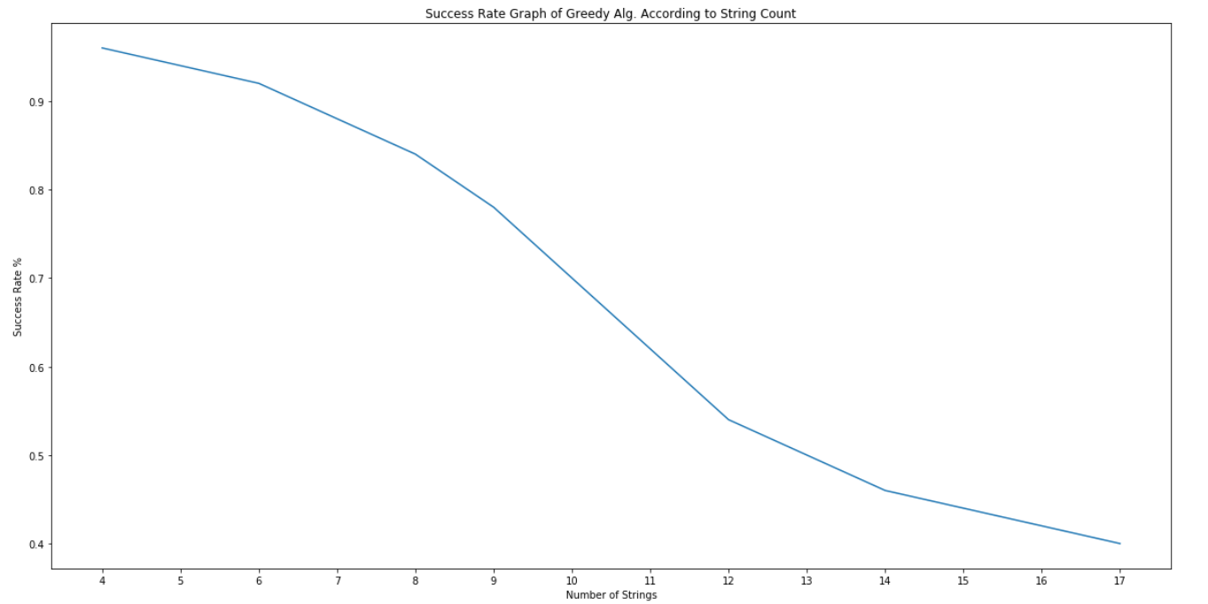
Success Rate Graph of Greedy Alg. According to String Count
It can be understood that while number of strings are increasing, chance of finding true shortest common superstring of our greedy algorithm is decreasing.

Slide 41
RUNNING TIME EXPERIMENTAL MEASUREMENT
For experimental analysis running time experimental measurement part, we created a function runningtime_test which gives us running time in seconds.
For the sake of accurate running time mean we run this function 20 times with per string count. And store them in a list.

Slide 42
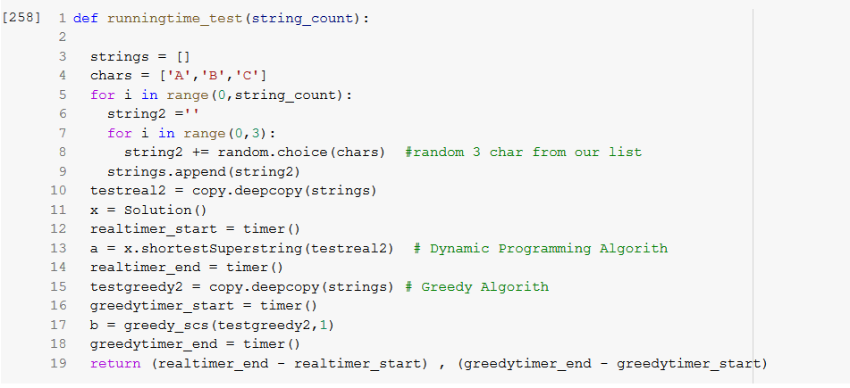
runningtime_test(String Count)

Slide 43
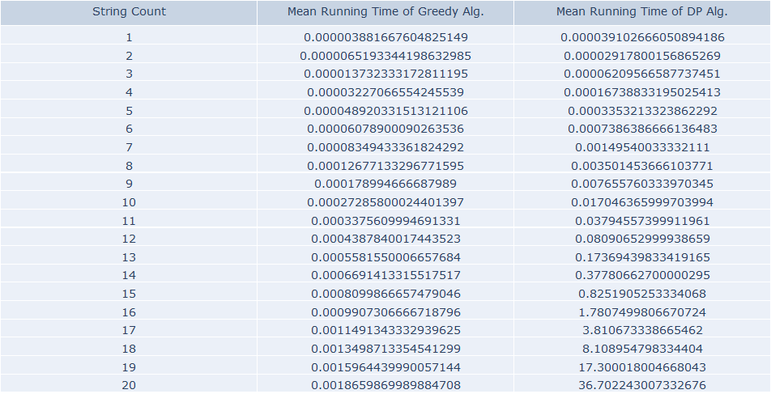
Running Time Table of Greedy Alg. and DP Alg. (Brute Force) According Number of Strings (20 Test)

Slide 44
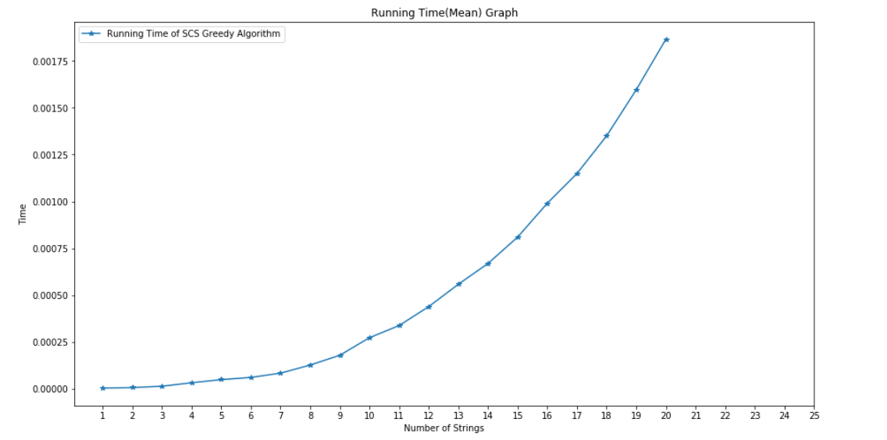
Running Time Graph of Greedy Alg. According to Number of Strings (20 Test)

Slide 45
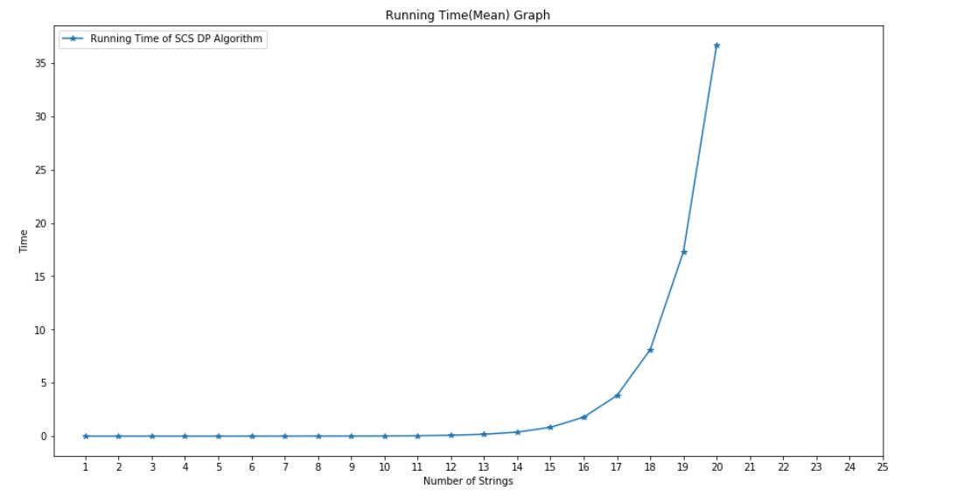
Running Time Graph of DP Alg. (Brute Force) According to Number of Strings (20 Test)

Slide 46
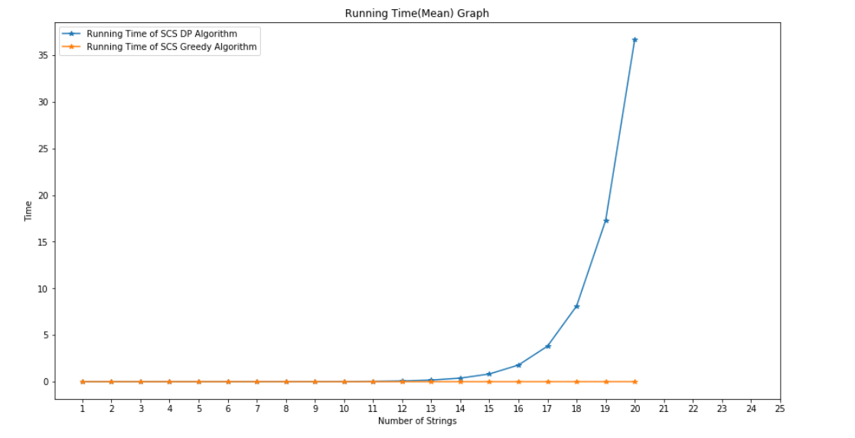
Running Time Graph of DP Alg. (Brute Force) and Greedy Alg. According to Number of Strings (Input)

Slide 47
DP and Greedy Algorithm
Even our greedy algorithm have cubic time complexity, DP Alg. of SCS’s time complexity is exponentially higher than Greedy Alg. of SCS seems linear in graph.
By using Greedy Algorithm we are decreasing of true output chance. But requirement of time for the result decreases dramatically.

Slide 48
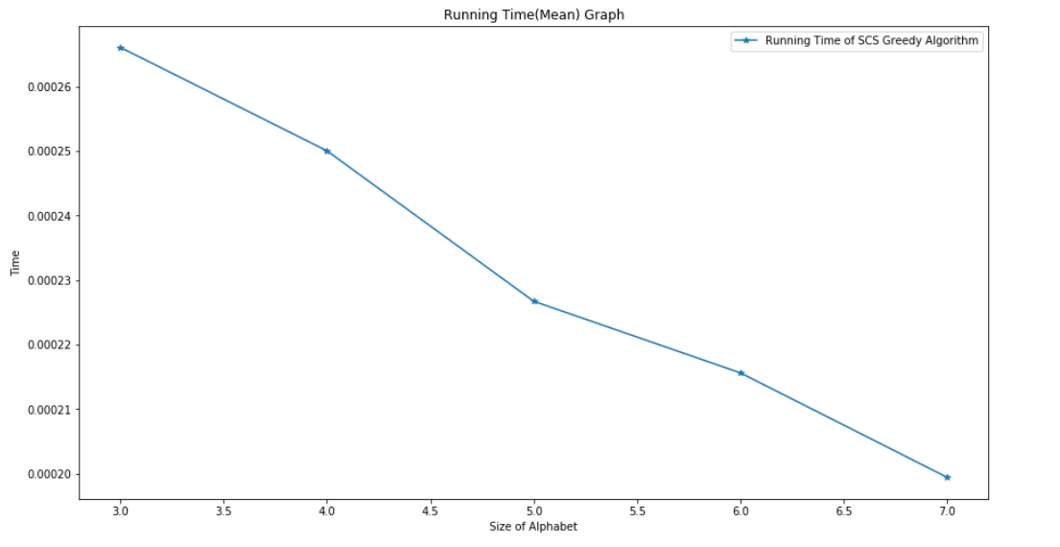
Running Time According to Alphabet Size with Fixed String Count
In this case we are fixing the input length (string count) and increasing size of out alphabet.

Slide 49
As shown in graph when size of Alphabet increases running time of SCS Greedy Algorithm is decreases. This is the result of overlap decreasement between strings with more Alphabet Size. So that loops run less for finding max overlaps.

Slide 50
Running Time(mean) Table According to Alphabet Size with Fixed String Count

Slide 51
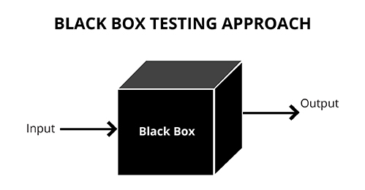
Black Box Testing
By definition black box testing is a method that examines the functionality of an application with no regards to its internal structure
There are few black box testing techniques that can be used
Some examples being equivalence class, boundary values and pair-wise testing.

Slide 52
Black Box Testing
Why equivalence class?
Equivalence class testing divides possible inputs into different classes.
After said classes are set, one sample from each is tested
We assume that if one sample passes the set, it is applicable to every sample in the said class.
We went with equivalence class because string is a wide subject that can be divided into multiple groups.

Slide 53
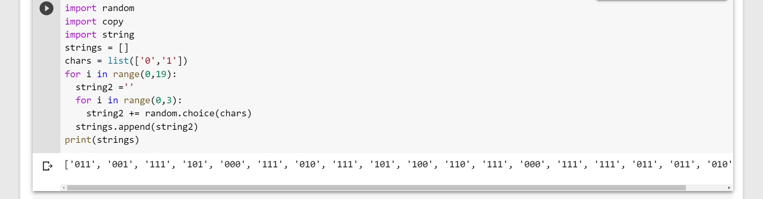
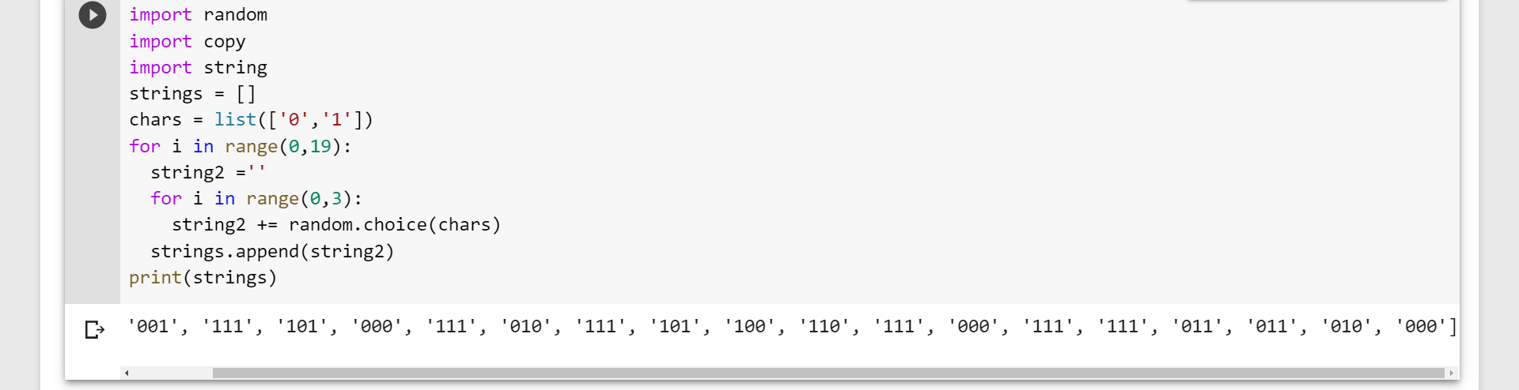
Black Box Testing
Lets see one example form each class that we tested
1) Binary Words (strings consisting of 1’s and 0’s)

Slide 54
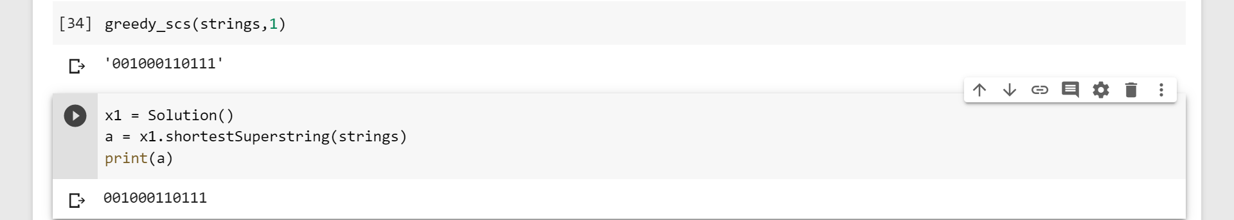
Black Box Testing
Here is the resulting superstring, calculated by greedy algorithm and proved with dynamic algorithm (Brute Force).

Slide 55
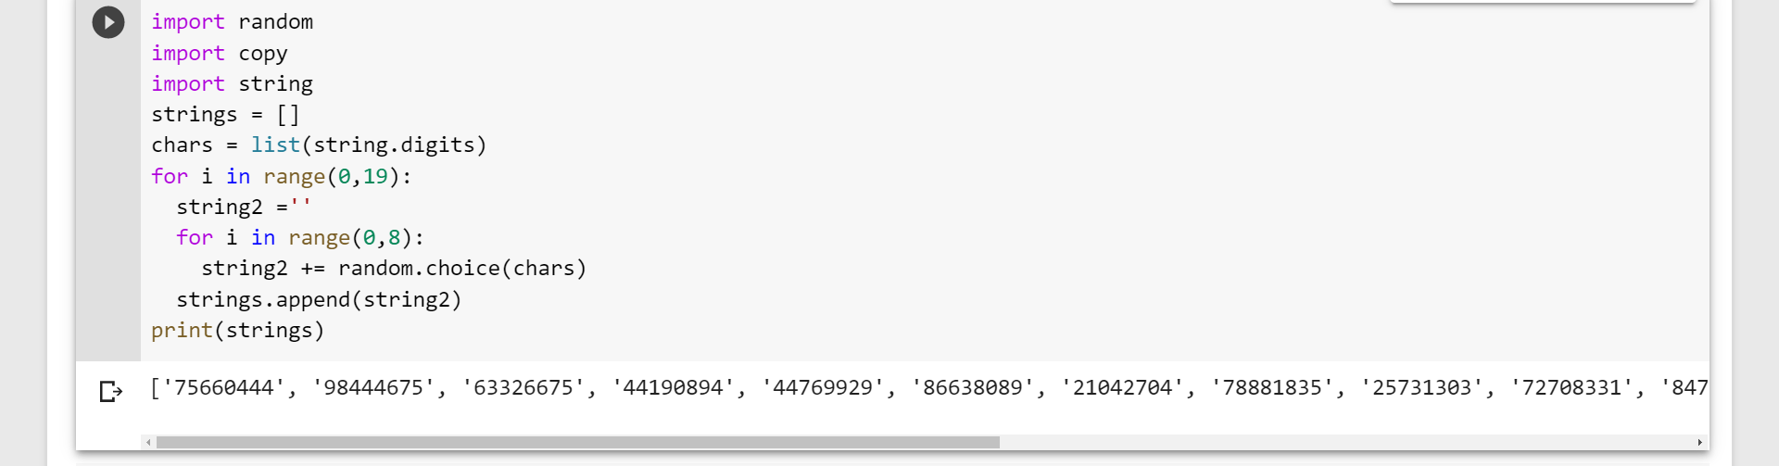
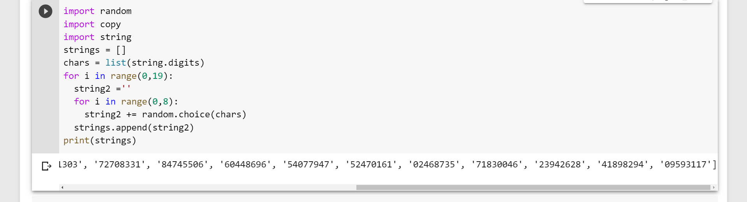
Black Box Testing
2) Alphabet 0-9 (Strings consisting of numbers)

Slide 56
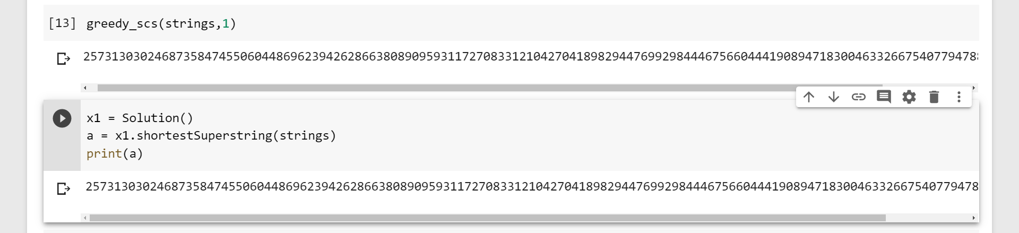
Black Box Testing
Resulting superstring

Slide 57
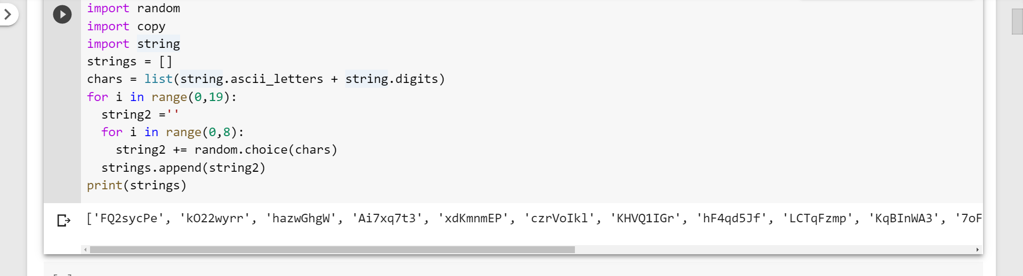
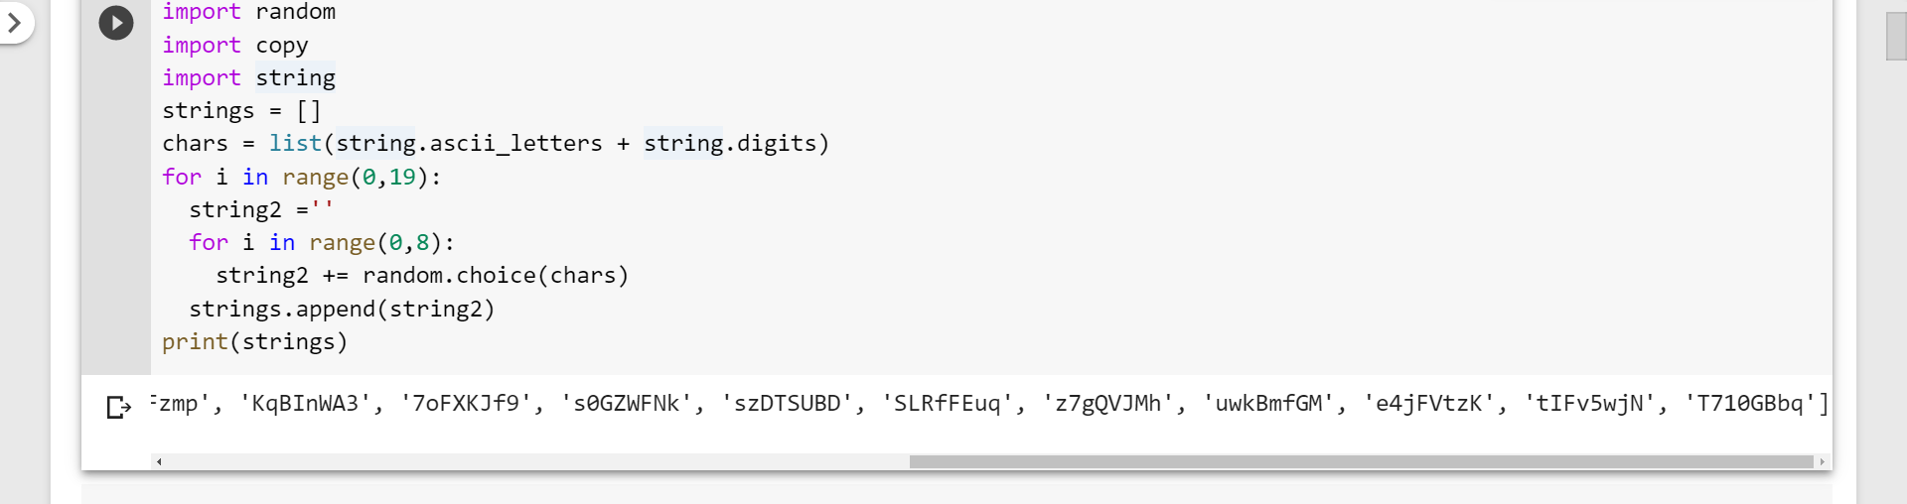
Black Box Testing
3) Alphabet a-z, A-Z, 0-9

Slide 58
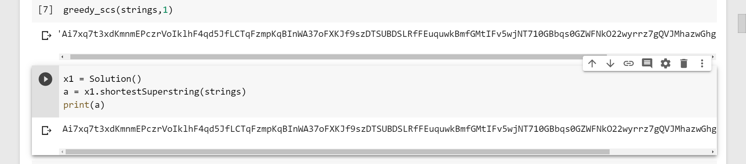
Black Box Testing
Result

Slide 59
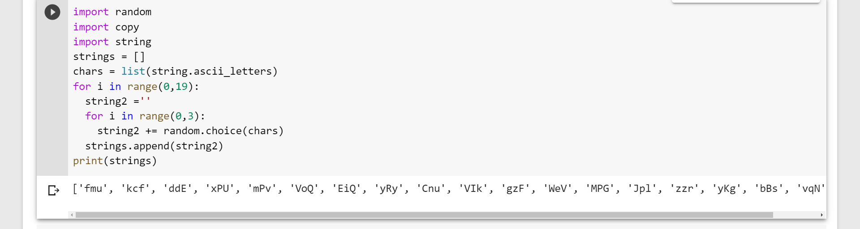

Black Box Testing
4) Short words (2-4 char long)

Slide 60
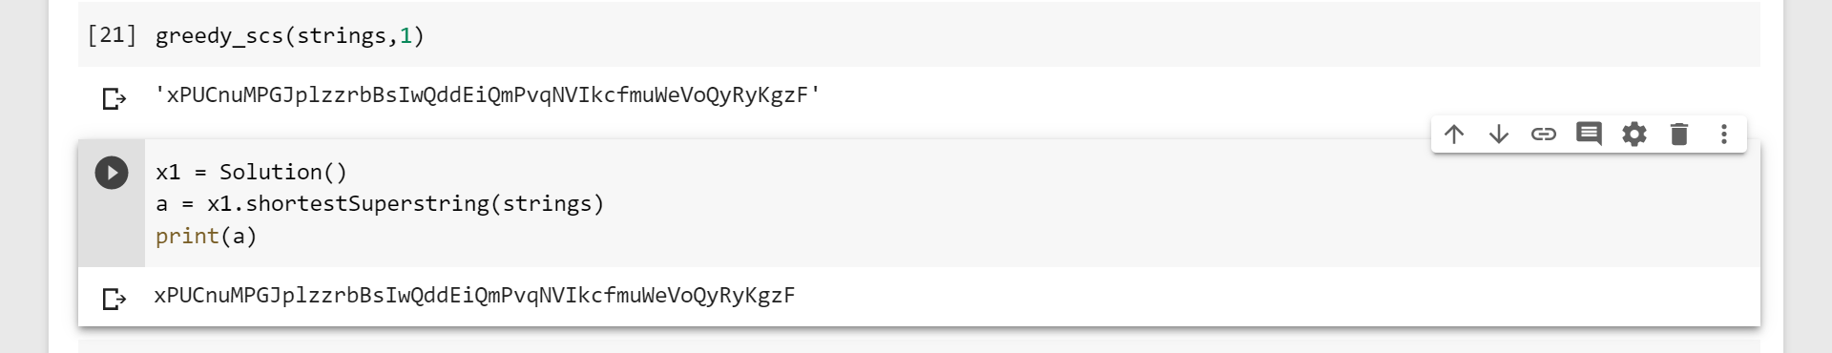
Black Box Testing
Result

Slide 61
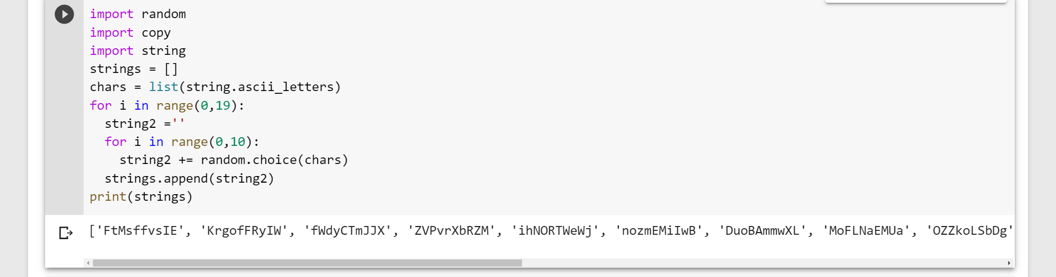
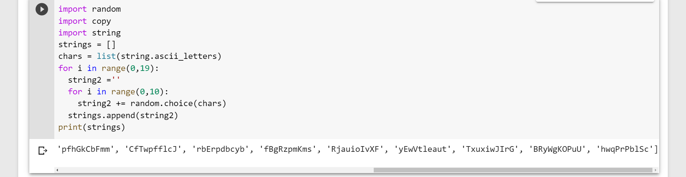
Black Box Testing
5) Long words (10-20 char long)

Slide 62
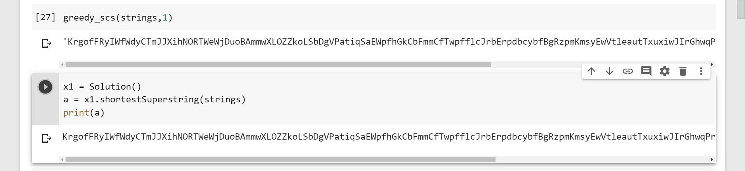
Black Box Testing
And once again the resulting superstring

Slide 63

Black Box Testing
As a result we concluded that our algorithm is applicable to all of these different string classes
Thus it passes black box testing

Slide 64
Conclusion
After experimental analysis of the algorithm, we used 4 strings and the correctness of the algorithm was 96%, when we increased the number of strings the correctness of the algorithm decreased to (94%, 92%, 88%,84%).The reason for the decrease is that greedy algorithm finds maximum overlapping pairs and chooses one arbitrary pair and unions them until there is only one string left but chosen pair of string does not always result in shortest common superstring. The increase in string number leads to decrease in correctness because the number of overlapping pairs increases.

Slide 65
Conclusion
To sum up all, Shortest Common Substring problem is a NP-Complete problem which we reduced the Vertex Cover problem to Hamiltonian Path problem and then to Hamiltonian Circuit which can be done in polynomial time. We analyzed the algorithm and this algorithm does not necessarily give the shortest common substring.
If we take into consideration of experimental analysis running time and algorithm analysis, our algorithm shows consistent characteristics of cubic type functions .

